Slide 1
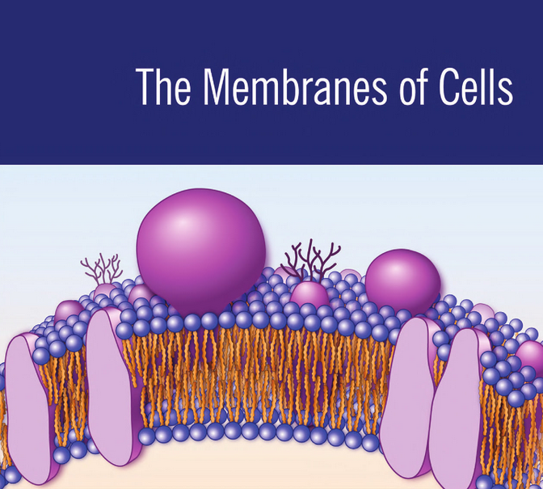

Slide 2
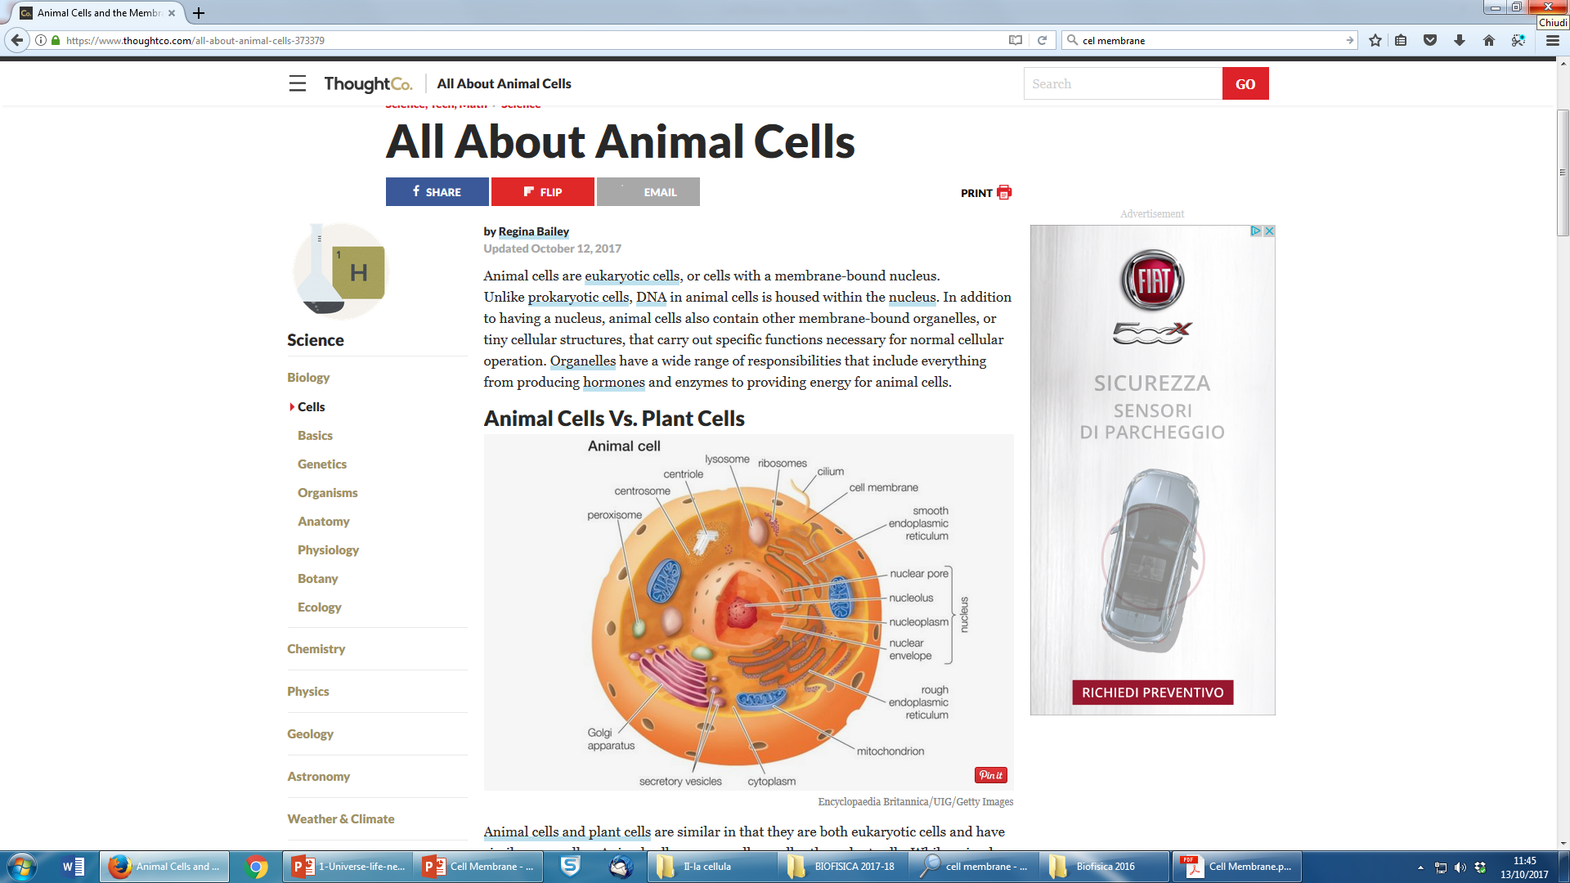
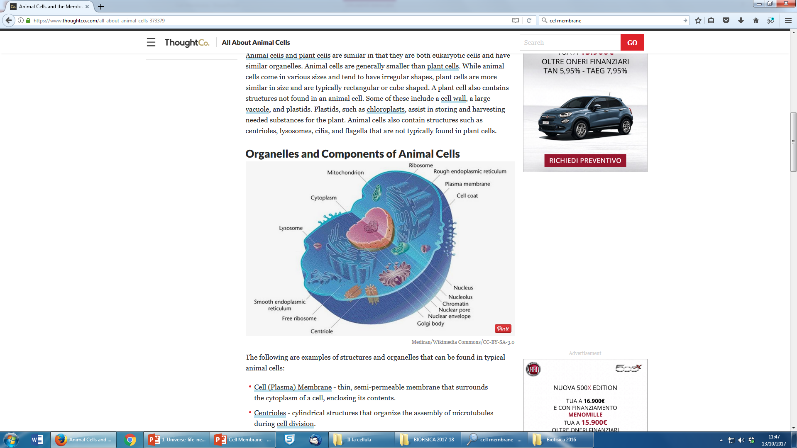

Slide 3
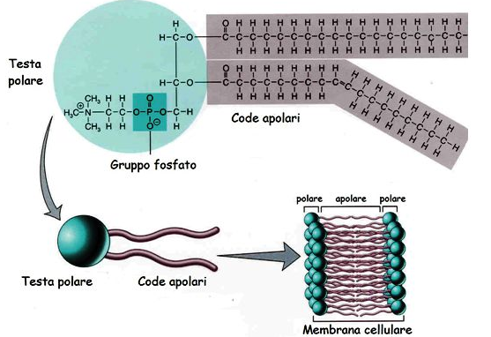
Polar Head
Polar tails
Polar Apolar Polar
Polar Head
Polar tails
LIPID MEMBRANE

Slide 4
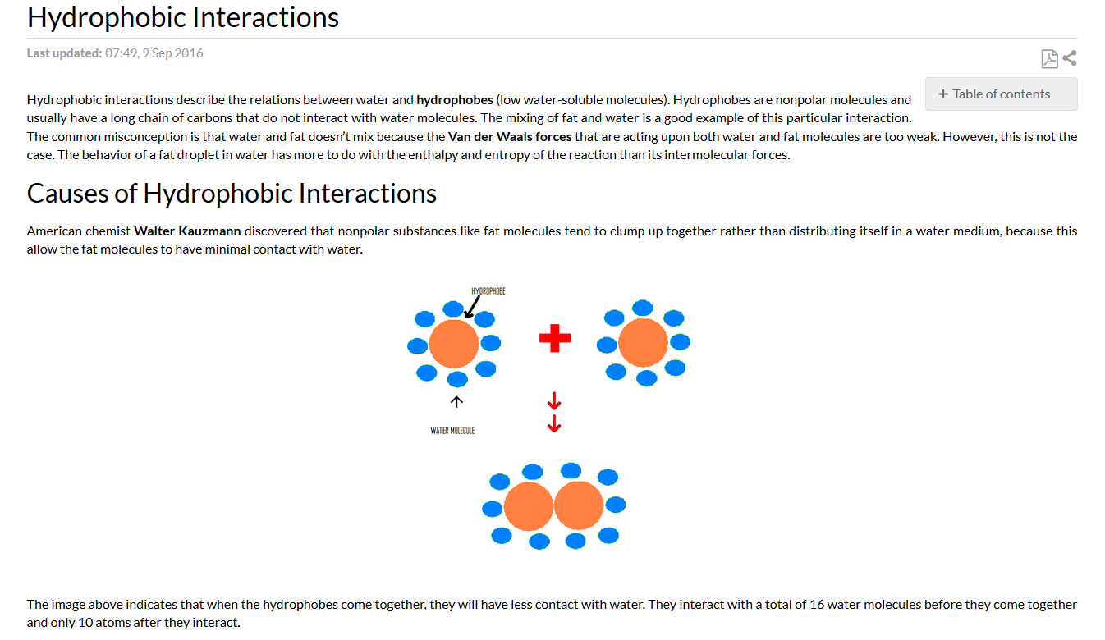

Slide 5
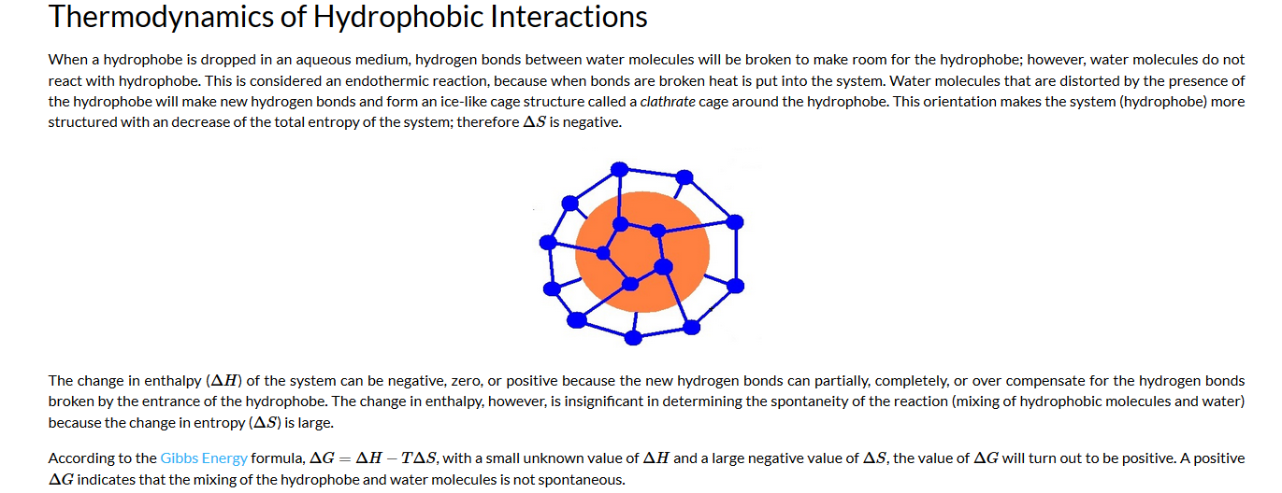

Slide 6
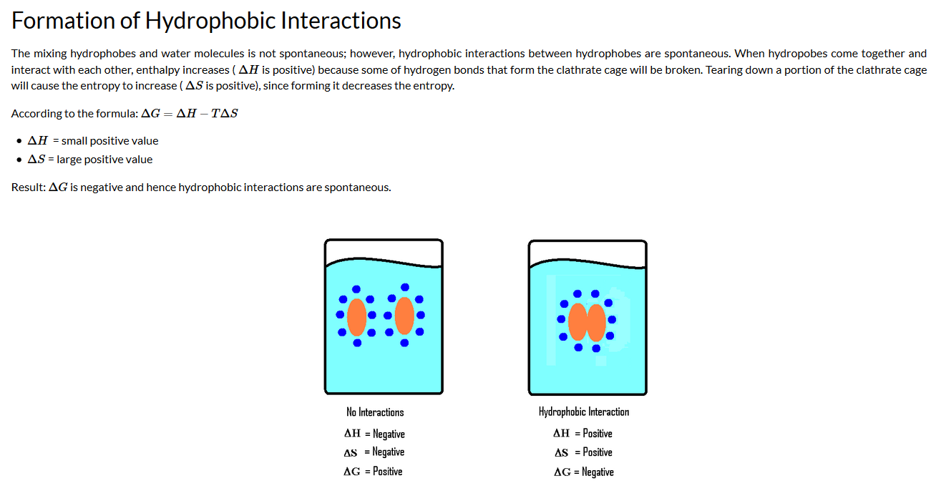

Slide 7
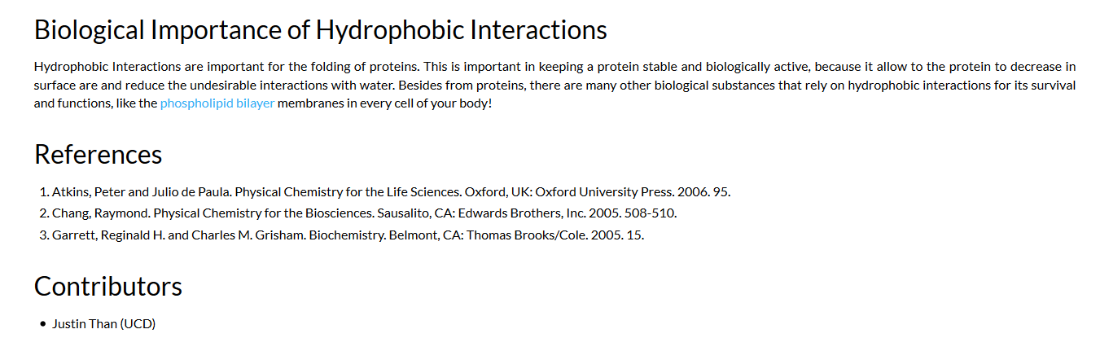
1)http://chem.libretexts.org/Core/Physical_and_Theoretical_Chemistry/Physical_Properties_of_Matter/Atomic_and_Molecular_Properties/Intermolecular_Forces/Hydrophobic_Interactions
2) https://www.ncbi.nlm.nih.gov/books/NBK26871/

Slide 8
Pairwise interactions for soft matter stability
http://chem.libretexts.org/Core/Physical_and_Theoretical_Chemistry/Physical_Properties_of_Matter/Atomic_and_Molecular_Properties/Intermolecular_Forces/Hydrogen_Bonding/Hydrogen_Bonding

